Slide 1
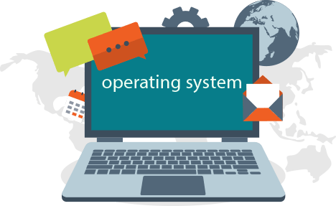
Operating System
Class: INTRO TO CIS - CS1101200
Theme: Operating System
Members:
1. Molly McPheeters
2. Austin Skidmore
3. Kyle Comins
4. Felipe Yamashiro Souza
5. Xhon Pelushi
Professor: Sayed Khushal Shah

Slide 2
Introduction
This is the final project for CS1101200. In this project, we gonna talk about what is an Operating System. How does it work? For what we need? Different kinds of Operating System. Their pros and cons. The features of those Operating Systems, explaining their purpose. A little bit background of history. We have decided to separate our duty in this way:
Molly McPheeters will talk about " Chrome Os", methodology and result.
Austin Skidmore will talk about " macOS", methodology and result.
Kyle Comins will talk about " CentOS 7", methodology and result.
Felipe Yamshiro Souza will talk about “Windows 10”, methodology and result.
Xhon Pelushi will talk about what is an Operating system, Abstract, Introduction, Conclusion.

Slide 3
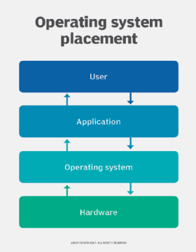
Methodology
What is an Operating System?
We can define Operating System as software that manages computers into doing different tasks. Manage software resources, hardware, and provide common services for computer programs. OS is the most important software on the computer. Without that computer can't run, can't work in the way that we think. To make it more clear. We sometimes hear that is for sale a computer without an Operating System. That hardware doesn't contain for the moment an Operating System because the seller wants to sell only the hardware but without that an Operating System that hardware can't run. The way how it works is this:

Slide 4
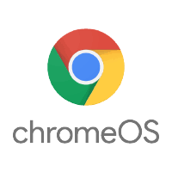
Google Chrom Os
Chrome OS is a Linux based operating system made and designed by Google. Google is a company that is like Microsoft but has created smart devices, cloud computing, and also is a search engine for the internet and research. Chrome OS is basically a browser for the web that makes the interaction and connection between users, apps, and data stored in the cloud of Chrome OS way easier than others. Chrome OS is an open-source operating system, also based on the Linux operating system itself. It uses 1/16 as much hard drive space as Windows operating systems and is intended for netbooks and/or tablet PCs that access Web-based applications and stored data from servers. The Chrome OS is so quick and fast that boot time is around seven seconds. When talking about Chrome OS and its operating system, there is one kind, but the operating system itself can always upgrade to better.

Slide 5
Whenever updated to another operating system, something was fixed from the previous operating system, maybe bugs or boot time, or new features coming out. Advantages for Chrome OS can be listed for pages, but the main advantage for users from Chrome OS is that it is so easy to use and maintain for everyone, no matter age. This advantage is so helpful to everyone around the world, because Chrome OS being so simple to use, it helps when people who struggle with technology and might not understand it as well as others. One clear disadvantage of Chrome OS is it is very redundant if a user owns other devices. It is not a "greater than normal" operating system as far as "cool" selling points are thought about. When an owner of a Chromebook, it is useless if the user already owns a Microsoft-based computer or Mac. Since Mac and Microsoft aren't Chrome OS based and produced, Google's operating system on them may be found difficult or redundant.

Slide 6
Chrome OS is an open-source operating system, also based on the Linux operating system itself. It uses 1/16 as much hard drive space as Windows operating systems and is intended for netbooks and/or tablet PCs that access Web-based applications and stored data from servers. The Chrome OS is so quick and fast that boot time is around seven seconds. When talking about Chrome OS and its operating system, there is one kind, but the operating system itself can always upgrade to better. Whenever updated to another operating system, something was fixed from the previous operating system, maybe bugs or boot time, or new features coming out. Advantages for Chrome OS can be listed for pages, but the main advantage for users from Chrome OS is that it is so easy to use and maintain for everyone, no matter age. This advantage is so helpful to everyone around the world, because Chrome OS being so simple to use, it helps when people who struggle with technology and might not understand it as well as others. One clear disadvantage of Chrome OS is it is very redundant if a user owns other devices.

Slide 7
It is not a "greater than normal" operating system as far as "cool" selling points are thought about. When an owner of a Chromebook, it is useless if the user already owns a Microsoft-based computer or Mac. Since Mac and Microsoft aren't Chrome OS based and produced, Google's operating system on them may be found difficult or redundant. Google Chrome Operating System is its own technique, it has so many different types of methods and techniques of its own. There will always be problems found in Operating Systems. Some frustrating problems found in Chrome OS are often when trying to download an important update, it will not seem to download, and often give an error. When needing to reset your Chrome OS, you may do a simple reset, but sadly that probably will not fix the problem. When talking about resetting, there are different types of resets to use, as in Hard Reset, a Power-wash, and a Recovery. Since there are different resets that you can do, that can lead to frustration and confusion when needing to just simply reset your operating system or computer.

Slide 8
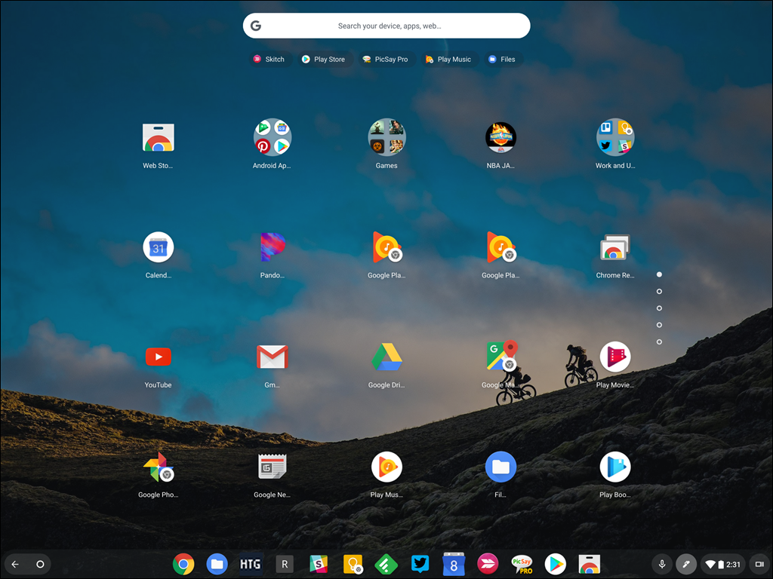

Slide 9
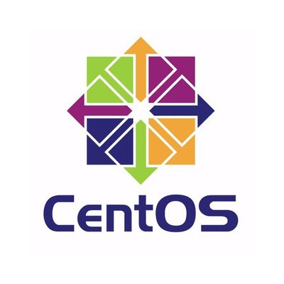
Linux CentOS 7
While CentOS 8 has been released, CentOS 7 is still the most common form of CentOS been used on servers as 8 is freshly released and requires major code updates for current systems. In this project, I will be describing what CentOS 7 is, what it can do, and why it is commonly used.
The original version of CentOS was released in May 2004. It now has 8 fully functioning versions and is built entirely from the Red Hat Enterprise Linux distribution. Most Linux servers worldwide are run on either CentOS or Debian as they are considered the most stable versions requiring no bug fixes or patches. As it contains binary compatibility, it is compatible with most Linux software. Additionally, most hosting control panels run on CentOS.
Because of its minimal version allowing specific components and software to be added, its possibilities are endless and versatile. The most common additions all revolve around servers. This includes but is not limited to installing Apache, setting static IPS, installing SSH, Nmap, and database tools..

Slide 10

The 5 most common reasons for people using CentOS 7 are as follows: 1) Security- It uses SELinux which is a control mechanism that allows enforcement of rules and policies while maintaining a reduced vulnerability level due to its lack of privilege escalation attacks. 2) Support- Each version of the OS (Currently 8 but commonly 7) is supported for 10 years since its release. If it requires fixes, updates, or support past that time; it is still readily available. 3) Managing Packages- Due to the command tool YUM, it keeps the system up to date and modular allowing for adding or removing components from the distro. It can function as many different software systems as possible from servers to hosting to a standard home computer. 4) Tips and Tricks- Due to its vast database of users and its long life span, there are documents and call lines and people that can easily help you with in-depth guides from a lowly level all the way to professional use. And 5) Management panel support- It can host multiple servers due to allowing multiple management panels to run simultaneously.

Slide 11
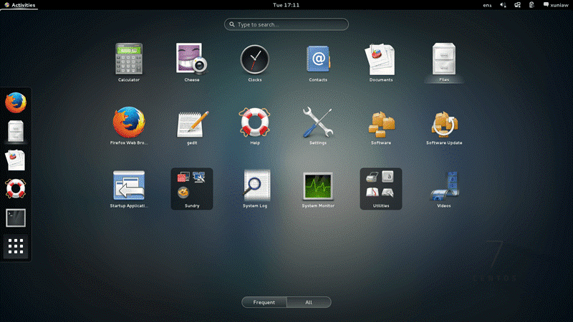

Slide 12
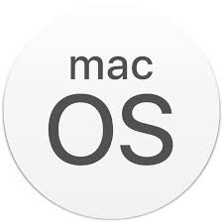
Mac OS
MacOS is an operating system designed and sustained by Apple Inc and is used as the primary operating system for their Mac computers. macOS is categorized as the second in the series of Macintosh operating systems, based on the Unix operating systems. Initially released in 2001 it has grown within the operating system market to be recognized as the second most popular operating system behind Microsoft Windows. The development of macOS dates back to Steve Jobs departure from Apple in 1985 and his creation of the company NeXT, where he would create the Unix-like operating system called NeXSTEP. NeXT would eventually be bought by Apple in 1996 and serve as the base kernel for the creation of macOS

Slide 13

To date macOS has gone through over 18 versions as it is known for being commonly updated and revised for improvement, usually once a year. Some of the most recent versions include:
macOS Catilina version 10.15.7
macOS Mojave version 10.14.6
and macOS High Sierra version 10.13.6

Slide 14
In the early stages of Mac OS X, Apple marketed its relative ease of use compared to other operating systems as Mac OS was a graphical user interface, or GUI, based This means unlike the other operating systems of the time, Mac was more graphically based in the sense of the use of icons instead of the previous use of commands and text prompts.
macOS is known for its suite of apps including many apps over Windows such as a superior video editor, music composition and full productivity. Often recognized as mac’s main selling point is its mobile integration capabilities. MacOS offers capabilities of sending messages and receiving your phones notifications directly through the The Airdrop capabilities allow almost instantaneous photo transfers through Iphones and other Apple products. notification panel.

Slide 15
This means unlike the other operating systems of the time, Mac was more graphically based in the sense of the use of icons instead of the previous use of commands and text prompts.
macOS is known for its suite of apps including many apps over Windows such as a superior video editor, music composition and full productivity. Often recognized as mac’s main selling point is its mobile integration capabilities. MacOS offers capabilities of sending messages and receiving your phones notifications directly through the The Airdrop capabilities allow almost instantaneous photo transfers through Iphones and other Apple products. notification panel.

Slide 16
The Airdrop capabilities allow almost instantaneous photo transfers through Iphones and other Apple products. Even built in Apple Watch customization is coming with the ability to turn on the computer through the watch coming. Mac is also often loved for its increased security and stability over Windows due to Apple better controlling its hardware ecosystem or not using third party drivers. The last thing to consider is that devices running macOS are often more expensive than their counterparts. This is due to mac being made to run on the specific hardware Apple produces and the build quality of Apple products being recognized as something they find very important. When being a mac, you are paying for a quality machine that runs an efficient OS.Lastly mac computers are able to run Windows in situations needed, but macOS can only be run on Apple computers. This gives the user the ability to choose which operating system they need in certain situations when using a mac.

Slide 17
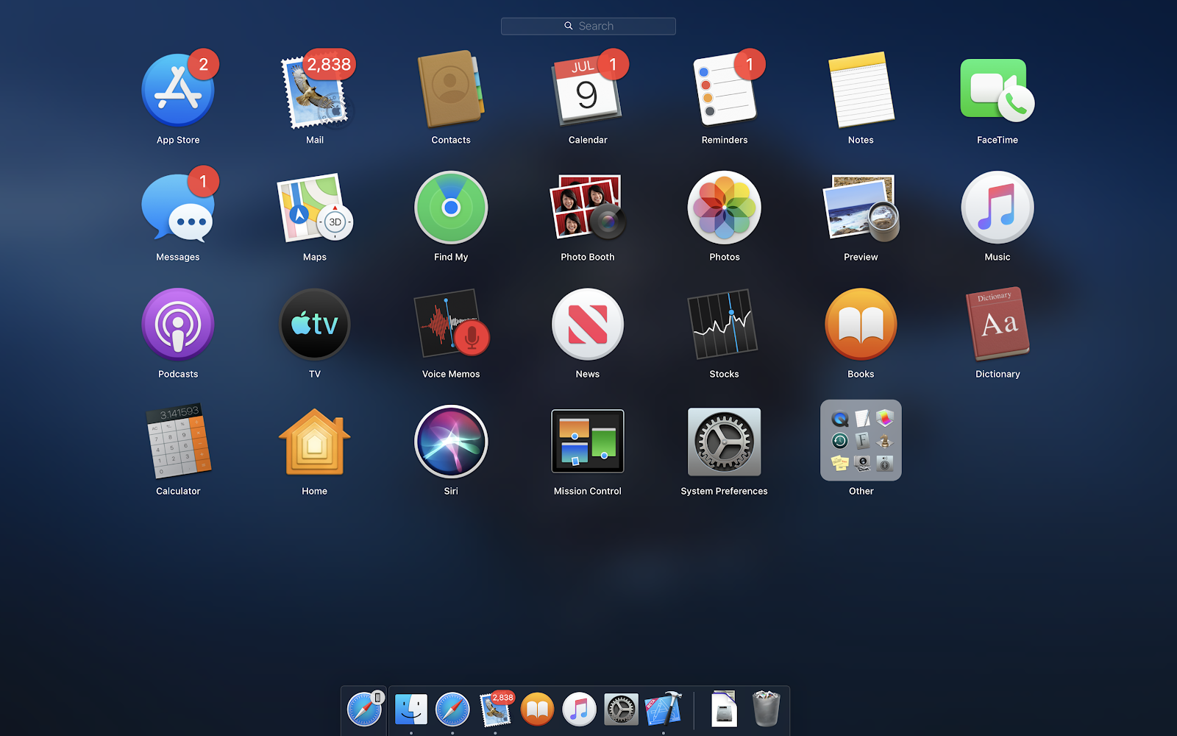

Slide 18
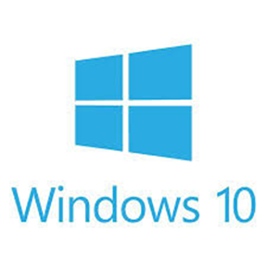
Windows 10
Windows 10 is a series of operating systems developed by Microsoft and released as part of its Windows NT family of operating systems, released on July 29, 2015. It lets you run several apps and programs simultaneously, each living within its own little window. That separation lets you spread several programs across the screen, sharing bits of information among them. Featuring metro or modern UI style will allow you to change settings and execute commands from the title bar instead of relying only on the charms menu.

Slide 19

Windows 10 introduces a new task view that will clearly show everything you’re working on side by side kind of like Mission Control on Apple OS 10 tasks you will even allow you to have multiple desktops open at once so that you can switch between a number of different workspaces quickly a huge productivity bonus for notebook users or anyone else who is limited to a single display. Microsoft Windows 10 also offers Cortana, which is like Siri on Apple devices, her purpose is to help the users to find what they are looking for, also voicing your computer, Cortana is now capable of finding what you are interested in even before you say it by digging around your personal details.
Also Microsoft is shifting its focus away from Internet Explorer and will be including an entirely separate browser, in addition to Internet Explorer,

Slide 20
Windows 10 called Spartan and features a new design philosophy, better compatibility with modern websites, a new rendering engine, and support for browser extensions. Windows 10 will ship with DirectX 12, which is designed to allow games to communicate more directly with your graphics hardware resulting in better performance and more realistic visuals. Windows users are now getting native support for flac lossless audio as well as HEVC a new video codec that supports 8K video. Also, during its release, If you had a PC with Windows 7 or 8.1 you could upgrade to Windows 10 for free during one year, although if you are buying a new grid it would cost you to have access to that operating system, starting at $139,99 for Windows 10 Home, and $199,99 for Windows 10 Pro.

Slide 21
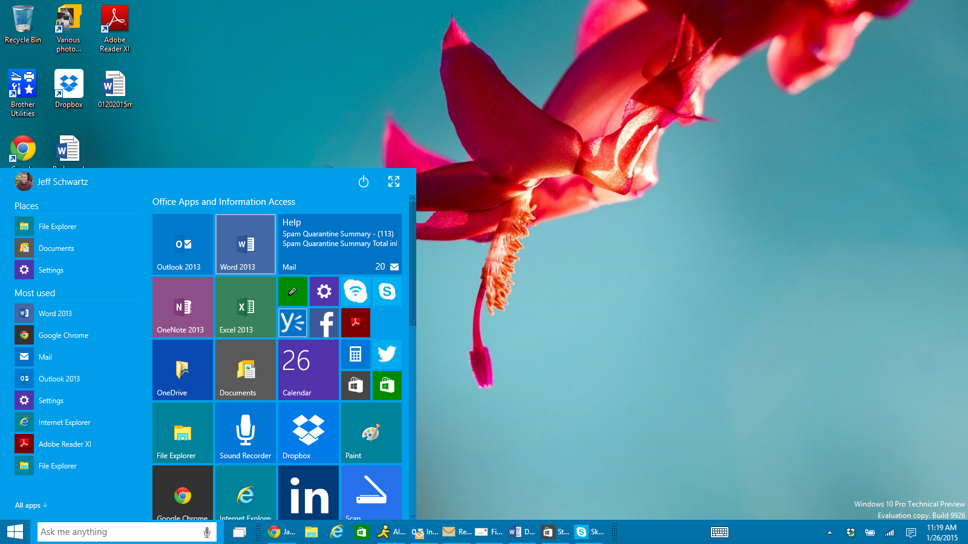

Slide 22
Result and Conclusion
In this project we understand what is and the important of an Operating System. Operating System it is the brain of an computer. A computer can’t run without it because OS is what makes a computer ran. In the market there are different types of OS such as : Google Chrom Os, Linux CentOS 7,Mac OS etc. They have their similarities and feature. Some times they are different because they are created for different purpose.
Google Chrome OS is a highly used operating system, because of its fast reaction time, and its ability to discover and explore the internet and world with the touch of a few buttons. Since Chrome OS is so easy, the popularity of it and usage of it throughout the United States, and even the world is outrages. in every update and worked through, all is good.

Slide 23
Yes, there are problems, just like every operating system out there, as long as they are fixed The way Chrome OS is so simple, it's very easy to function and work, but also is easy to learn and work around when struggling with it.
Centos 07 have his feature starting by the main point that is free software. Some of the advanced things you can do with CentOS are machine language programming, terminal tracing, and advanced security testing and maintenance.
MacOS is known for its ease of use as it was created to work flawlessly with the hardware it is run on. It comes pre-loaded with an extensive collection of apps to make everyday things such as web browsing and emails easy. operating system.

Slide 24
References
Bonheur, Kristoffer. “Advantages and Disadvantages of Chrome OS.” Version Daily, 7 June 2019,
www.versiondaily.com/advantages-disadvantages-chrome-os/
Rouse, Margaret. “What Is Google Chrome OS? - Definition from WhatIs.com.” WhatIs.com, TechTarget, 3 Feb. 2012,
www.whatis.techtarget.com/definition/Google-Chrome-OS
Lacoma, Tyler. “Common Chromebook Problems and How to Fix Them.” Digital Trends, Digital Trends, 28 Oct. 2020,
www.digitaltrends.com/computing/common-chromebook-problems-and-how-to-fix-them/
Vermaat Misty E. "Enhanced Discovering Computers ". 2017,01.

Slide 25
Thank you!

